Slide 1
Renormalized Entanglement Entropy of Mass-deformed ABJM Theory
YongPyong-High1 2015,
Joint Winter Conference on Particle Physics, String and Cosmology
In collaboration with Chanju Kim, O-Kab Kwon
Based on arXiv15xx,xxxx,
Phys.Rev. D90 (2014) 4, 046006 ,
Phys.Rev. D90 (2014) 12, 126003
with O. Kwon, Chanyong Park and hyenjoon Shin.
Kyung Kiu Kim
(Gwangju Institute of Science and Technology)

Slide 2
contents
Entanglement Entropy
Holographic Entanglement Entropy(Ryu-Takayanagi formula)
1+1 d case(Mass-deformation for 1+1 d by cutting)
C theorem in 1+1d
F theorem in 2+1d
Renormalized entanglement entropy for F
LLM geometry and mass deformed ABJM
REE near UV
Summary

Slide 3
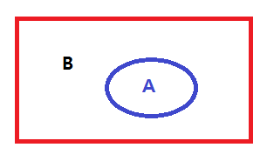
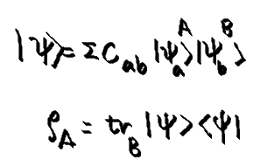
Entanglement Entropy
Quantity measuring spatial entanglement of a state
The state(Usually ground state) is given by ∑CAB A X B where A and B are basis wave functions of Hilbert spaces Ha and Hb. Ha and Hb are apart from each other spatially.
Definition

Slide 4
Simple example : two points and two spins
Maximum entanglement entropy
Minimum entanglement entropy with a trivial Hamiltonian

Slide 5
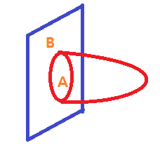
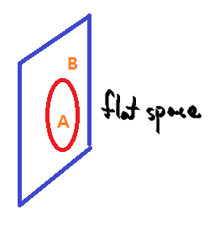
Holographic Entanglement Entropy(Ryu-Takayanagi formula)
Area of minimal surface in AdS = Entanglement entropy of CFT
A: entangling surface
Agreements with CFTs in 2d 3d 4d ….

Slide 6
From the field theories(2 dimensions and higher dimensions
Minimal surfaces have same structure of these UV divergences.

Slide 7
1+1 d case
From field theory 94’
Minimal surface(geodesic) in AdS3
Mass deformation
C. Holzhey, F. Larsen and F. Wilczek,

Slide 8
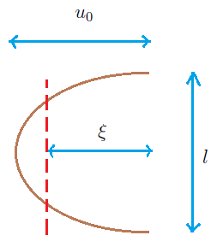
Computation through HEE
= log ( tan s/2 )

Slide 9
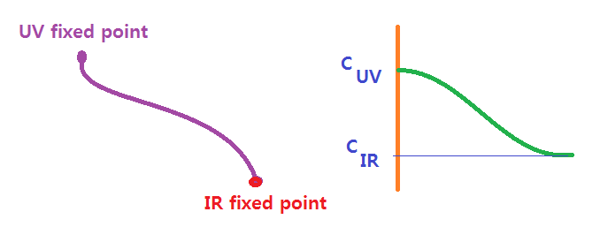
C theorem in 1+1 d
Decreasing c function under RG flow
Zamolodchikov 86, Cardy 88, Komargodski-Schwimmer 11
Is there a 3 dimensional version?
F-theorem in 2+1 d
F= - log Z : free energy decreses ?

Slide 10
F theorem
(Jafferis-Klebanov-Pufu-Safdi 11, Myers-Sinha 10 ) F_UV > F_IR
For CFT_3 [Casini-Huerta-Myers 11 ]

Slide 11
Renormalized entanglement entropy for F
Liu-Mezei 12
We will follow this prescription.
The goal of this work is to show that F can be a c function by controlling mass deformation.
UV -> IR : The mass becomes bigger
CFT -> massive theory
We will take the ABJM theory as a probe theory.

Slide 12
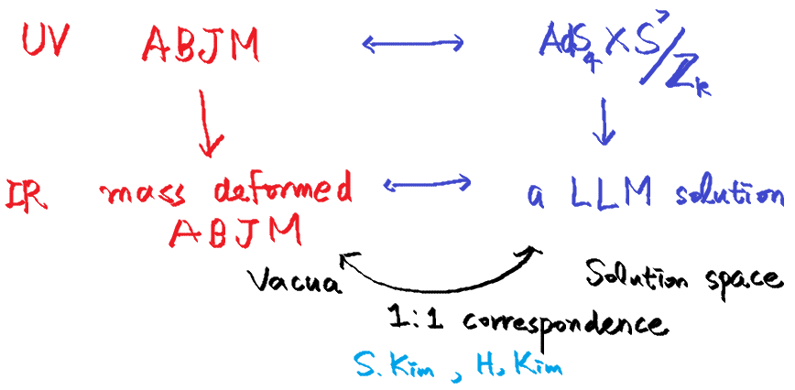

Slide 13
LLM geometry for the mass-deformed ABJM theory
The dual geometries are given by solutions of the 11 dimensional super gravity with an appropriate ansatz using the bubbling geometry technique.
Ignoring the Z_k modding, the M2 brane world-volume theory has SO(8) R symmetry.
By the mass deformation, this R-symmetry is broken to SO(4)XSO(4).
So the metric has two S3 spheres and the 4-form field strength also contains the S3 volume forms .

Slide 14
The 11 dimensional killing spinor has a structure roughly - ( S3 Killing spinor) X ( B : spinor in the other space)
Using this B, one can construct spinor bilinears
~ B (Gamma Matrices) B
This construction gives (pseudo) scalars, (pseudo) vector, 2 forms, 3 forms, …, and so on, which are part of the metric and the field strength.
Finally, one can obtain following solution.

Slide 15
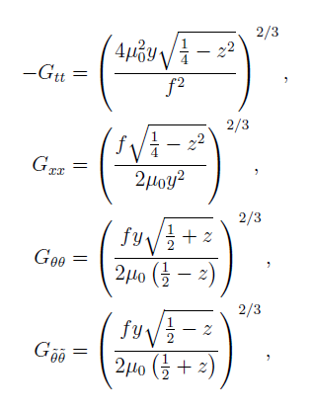
Considering Z_k modding and SO(2,1) isometry to the Ansatz give the solution we will consider as follows.

Slide 16
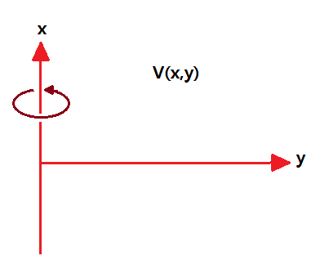
Thus the z(x,y) and V(x,y) determine the geometry and the field strength.
By Susy and the equation of motion, z(x,y) and V(x,y) are related to each other. They are not independent.
The equation for V(x,y) is nothing but the Laplace equation in the cylindrical coordinates.

Slide 17
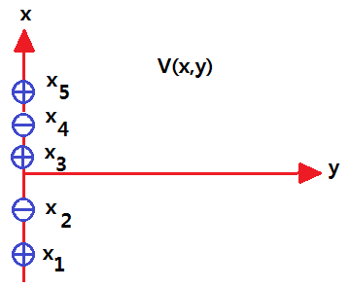
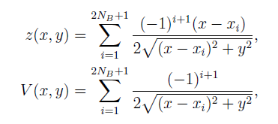
So V(x,y) is given by the scalar potential produced by charges sitting on y=0 line.
To make the asymptotic geometry AdS4, the sum of the charges should be 1.

Slide 19
Discrete vacua for the mass-deformed ABJM theory
There are infinite number of discrete vacua encoded by VEV of the scalar field.
GRVV matrix

Slide 20
Vacuum solutions

Slide 21
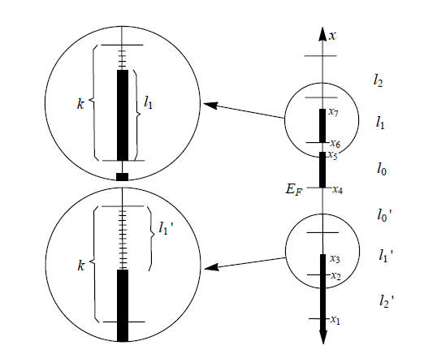
For super symmetric vacua ( S. Kim H. Kim and Cheon)
This gives a constraint for x_i s.
Matching with gravity solution
N_n = l_n

Slide 22
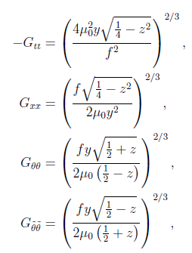
Holographic entanglement entropy for the Strip case.
To consider the minimal surface,
The induced metric is given by

Slide 23
We are considering target space map for the strip as follows.
To avoid Partial differential equation, we take into account
This is valid, when the minimal surface is far from the droplets and the charge distribution is close to symmetric configuration.
Since our interest is behavior near UV fixed point and symmetric charge distribution so far.

Slide 24
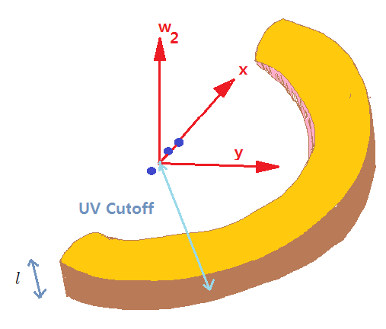
The minimal surface

Slide 25
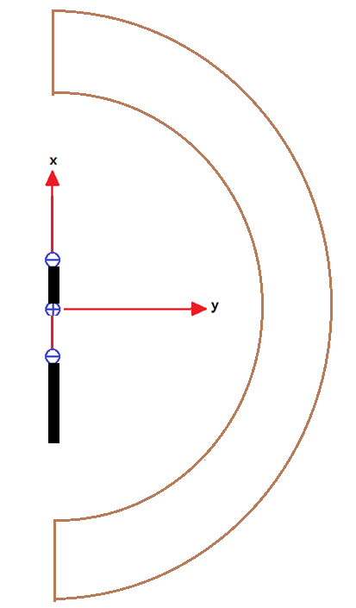
For symmetric droplet case.
So the free energy( c function )

Slide 26
Holographic entanglement entropy for the Disk case.
The target space map is given by
The minimal surface Lagrangian is
In the small mass approximation

Slide 27
Substituting l, the minimal surface, the holographic entanglement for the strip case.
The renormalized entanglement entropy is

Slide 28
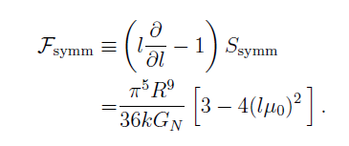
DISK case
The c-function is
For general case

Slide 29
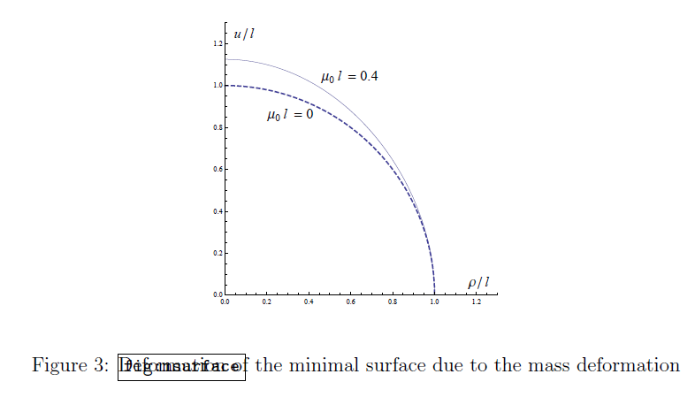
Because of the AdS metric factor, the minimal surface has a counter-intuitive shape as follows.

Slide 30
For general droplets, the holographic entanglement entropy is given by
For k= 1 and the symmetric droplet case,
The entanglement entropy is

Slide 31
The c-function is
For general case

Slide 32
For the symmetric case, the c-function or the partition function shows the monotonic decreasing behavior.
For the general case, it is not guaranteed. We need to investigate the validity of our computation and the modification of the coefficient.
?

Slide 33
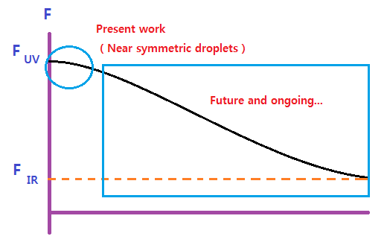
F theorem is valid near UV fixed point for symmetric configuration .
It’s not true for general configuraiton.
REE is a good choice for a c function. But PDE effect?

Slide 34
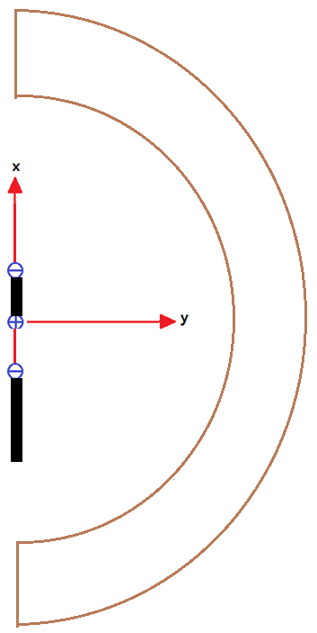
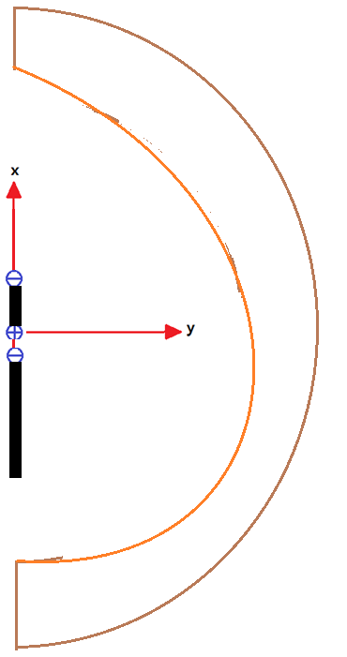
The PDE effect
We have ignored the distorted effect from the asymmetric configuration of the droplets.

Slide 35
For PDE effect

Slide 36
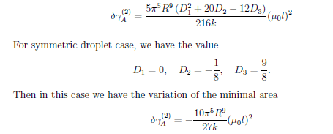

Slide 37
F theorem is valid near UV fixed point for all the vacuum configuraitons .
REE is a good choice for a c function. But PDE effect? Now OK!

Slide 38
Up to
Symmetric case

Slide 39
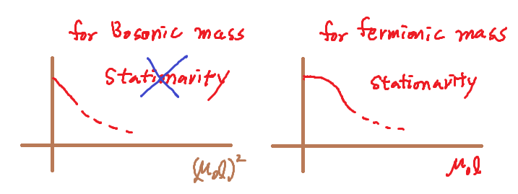
Summary
We calculated HEE for mass deformed ABJM theory with small mass approximation.
The UV behavior are consistent with F theorem. ( decreasing c function F ) for all the vacua.
Stationarity

Slide 40
Summary
IR behavior and finite mass computation are on-going.
Thank You for Listening!

